Slide 1

Stock Price Predictions
Miguel Ari, Grace Barnett, Ivan Galeano, Angela Narag, Camera Leslie, Tanaz Sayan

Slide 2
Project statement
The objective of this project is to leverage historical stock data from Yahoo Financial and employ machine learning techniques to forecast future stock prices. By comparing the performance of various models, including LSTM neural network, linear regression, random forest, and ARIMA - we aim to validate our thesis that a neural network model would yield superior accuracy in predicting stock prices. Through the analysis of key metrics and comparison of our predicted prices vs. actual closing prices, our goal is to identify the model that consistently provides the most accurate stock price forecasts, providing valuable insights for investors and traders in the financial market.

Slide 3
Thesis
Thesis:
Utilizing a neural network model would yield superior accuracy in predicting stock prices.
We hypothesized that the neural network model would outperform the other models due to its ability to capture complex patterns and nonlinear relationships in the data.
Approach:
Compared the performance of various models, including linear regression, random forest, and ARIMA, to validate our thesis.
Each model was assessed based on their ability to accurately forecast stock prices using historical data.
By comparing the predictions generated by different models, we aimed to identify the model that consistently provided the most accurate stock price forecasts.
Key Metrics:
We evaluated the models based on metrics such as mean absolute percentage error (MAPE), mean squared error (MSE) and mean absolute error (MAE) to quantify the prediction accuracy.

Slide 4
Using a Neural Network: LSTM (Long Short Term Memory Model)
The LSTM (Long Short-Term Memory) neural network is widely regarded as one of the most popular machine learning approaches for stock market prediction within the Wall Street community.
LSTM networks excel in analyzing stock market data by capturing long-term dependencies, detecting complex patterns, and accurately forecasting future price movements.
The unique architecture of LSTM networks, with memory cells retaining information over extended periods, improves prediction accuracy by effectively learning and remembering important features and patterns from historical stock data.
LSTM networks are flexible and can incorporate multiple inputs such as stock prices, trading volume, technical indicators, and market sentiment, enhancing their predictive power by considering diverse data sources.
Notes:
LSTM networks are ideal for analyzing stock market data due to their ability to capture and learn long-term dependencies in sequential data, enabling the detection of complex and non-linear patterns commonly observed in the stock market.
LSTM networks excel in modeling and predicting temporal dynamics by effectively processing and retaining information from previous time steps, making them well-suited for accurately forecasting future price movements in the dynamic and evolving stock market.
The unique architecture of LSTM networks, featuring memory cells that retain information over extended periods, enables the model to learn and remember important features and patterns from historical stock data, resulting in improved prediction accuracy.
The flexibility of LSTM networks allows for the incorporation of various inputs, including stock prices, trading volume, technical indicators, and market sentiment, enhancing the predictive power of the model by considering diverse data sources.

Slide 5
Data
Daily stock closing prices for Goldman Sach (Ticker: GS) from Yahoo Finance
Majority of the models used at minimum 3 years worth of data ending June 1, 2023
Depending on the model, historical data was increased
Federal Funds Effective Rate from FRED
Downloaded the rate from the Federal Reserve Economic Data online database
Bollinger Bands
Calculated the Bollinger Bands based on the Goldman Sachs Historical Price Data
It is used to assess price volatility and identify potential price reversal points in financial markets.

Slide 6
Key Metrics Used
Mean Absolute Percentage Error (MAPE) - is a widely used evaluation metric for forecasting models, particularly when there is significant variability in the scale of the target variable. It represents the average percentage difference between predicted and actual values.
Mean Absolute Error (MAE) - is calculated by taking the average of the absolute differences between the predicted and actual values. It measures the magnitude of the errors without considering their direction.
Root Mean Squared Error (RMSE) - is measures the square root of the average of the squared differences between the predicted and actual values. It gives more weight to larger errors due to the squaring operation.
A low MAPE, MAE, and RMSE indicate higher accuracy, as it means the predictions are closer to the actual values.

Slide 7
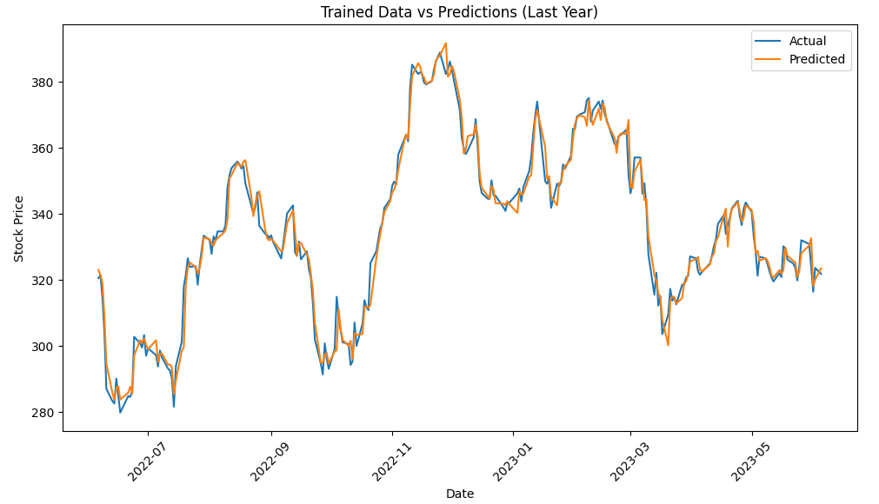
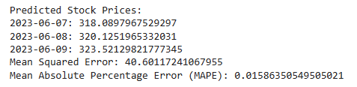
Model 1 - Linear Regression
Best Characteristics:
Simplicity: The underlying assumption of a linear relationship
Efficiency: Linear regression models are computationally efficient and can handle large datasets with many features.
Worst Characteristics:
Linearity Assumption: Linear regression assumes a linear relationship
Sensitivity to Outliers: Linear regression can be sensitive to outliers
Assumption of Independence: Linear regression assumes independence among the observations
Run time: Less than a minute

Slide 8
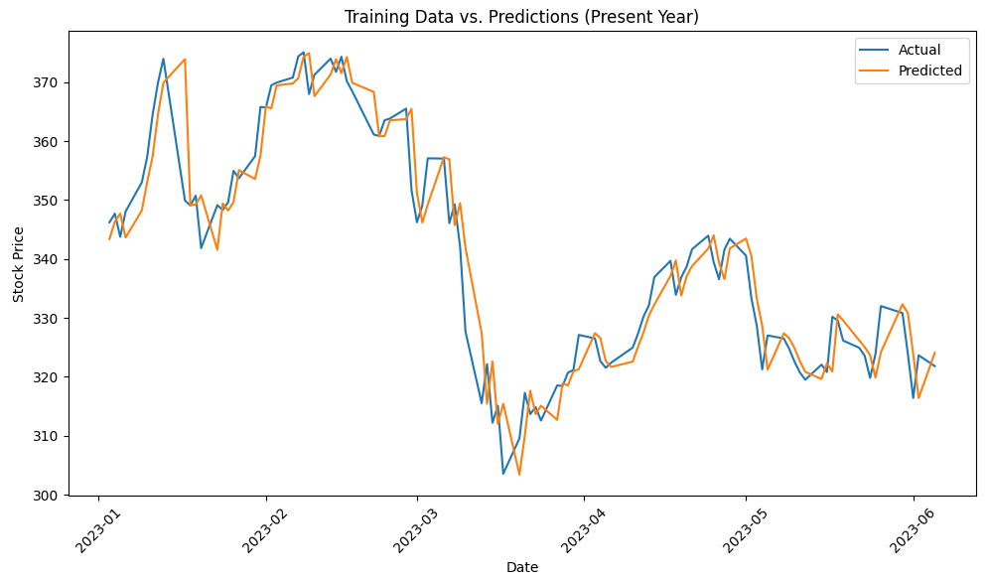
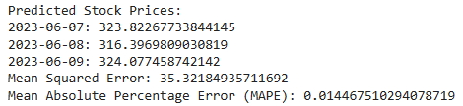
Model 2 - Random Forest
Best Characteristics:
Robustness to Overfitting: Random Forest is less prone to overfitting compared to individual decision trees
Nonlinear Relationships: Random Forest can effectively capture nonlinear relationships
Worst Characteristics:
Lack of Interpretability: Challenging to understand the individual decision rules of each tree
Black Box Nature: While Random Forest provides accurate predictions, it operates as a black box model.
Run time: Less than a minute

Slide 9
Model 3 - ARIMA (Autoregressive Integrated Moving Average)
Autoregressive (AR)
Refers to the dependency of the current value on previous values of the same series.
The current value can be predicted based on a linear combination of its own past values.
The order of the autoregressive component, denoted as “p”, determines the number of lagged terms considered in the model
Notes:
ARIMA is a statistical method used to forecast future values based on past observations of a time series data set.

Slide 10

Model 3 - ARIMA (Autoregressive Integrated Moving Average)
Integrated (I)
Refers to the differencing of the time series data to make it stationary.
Stationarity implies that the statistical properties of the series, such as the mean, variance, autocorrelation, do not change over time.
The order of differencing, denoted as “d” indicates the number of times differencing is applied to achieve stationarity.

Slide 11
Model 3 - ARIMA (Autoregressive Integrated Moving Average)
Moving Average (MA)
Relates the current value to the residual errors of the model from previous time periods.
It assumes that the current value is influenced by random shocks or noise in the data that is not accounted for by the autoregressive (AR) or integrated (I) components.
The order of the moving average component, denoted as “q”, determines the number of lagged forecast errors included the model.

Slide 12
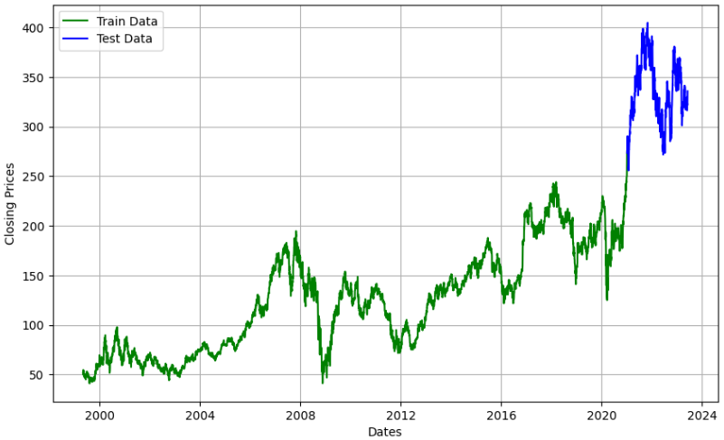
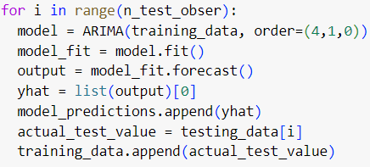
Model 3 - ARIMA (Autoregressive Integrated Moving Average)
Split data into test and training set
ARIMA with: p=4, d=1, q=0
Notes:
We imported the ARIMA model from the stats models library

Slide 13
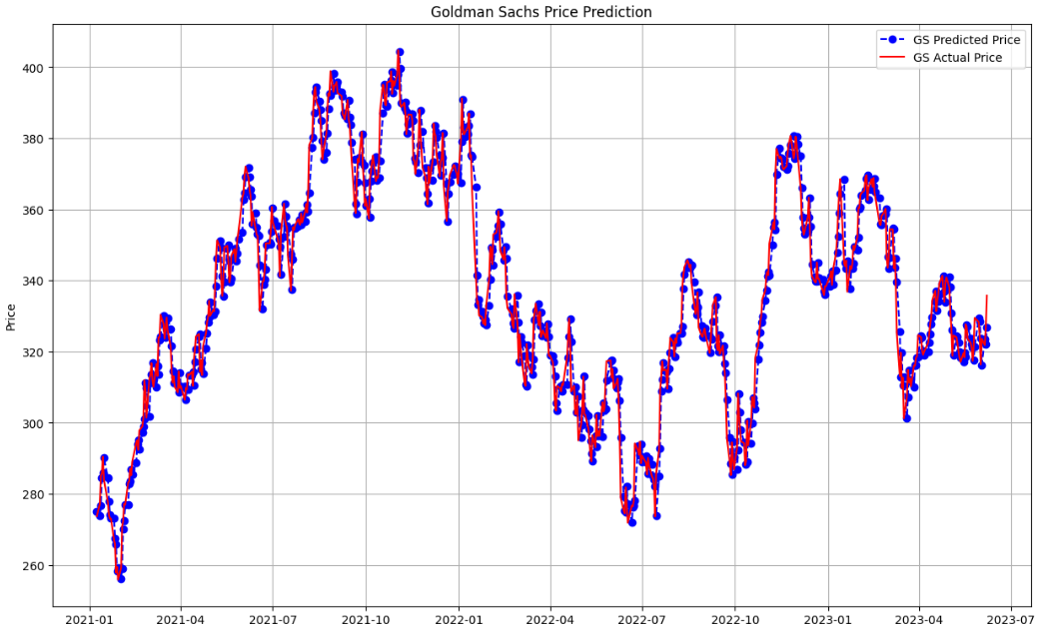
Model 3 - ARIMA (Autoregressive Integrated Moving Average)
Runtime: 9 mins.
MAPE: 1.32%
MAE: $4.39
RMSE: $5.66
Notes:
Mean Absolute Percentage Error, Mean Absolute Error, Root Mean Square Error

Slide 14
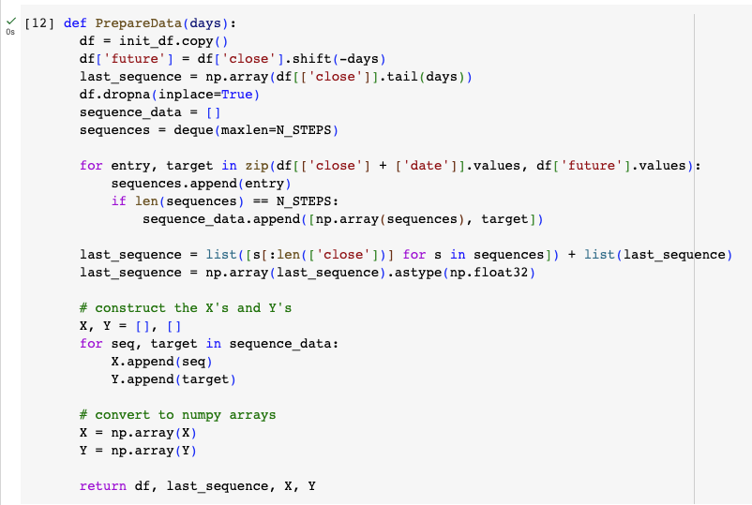
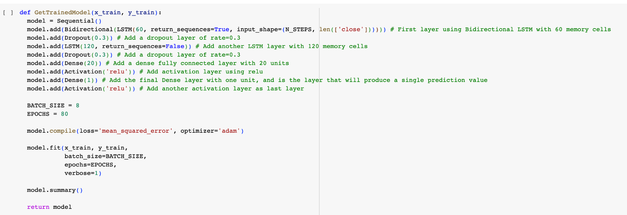
Model 4 - LSTM using Closing Price Only
Sequential LSTM model with 8 layers
80 Epochs
MAPE:
Notes:
For the LSTM model, we created 2 functions.
The first one is called PrepareData which creates the input (X) and target (Y) arrays for training. It takes the number of days (days) as input and creates sequences of historical data and corresponding target values.
The model architecture is defined and trained using the GetTrainedModel function. It uses bidirectional LSTM layers, dropout layers for regularization, dense layers, and activation functions. The model is compiled with the mean squared error loss function and the Adam optimizer. It fits the model to the training data (x_train and y_train) for a 80 number of epochs.

Slide 15
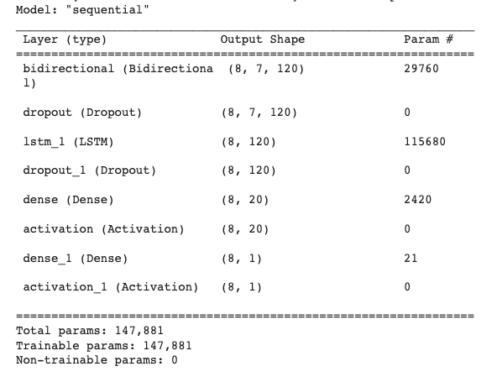
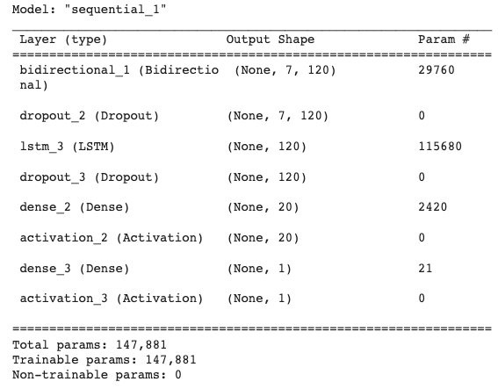
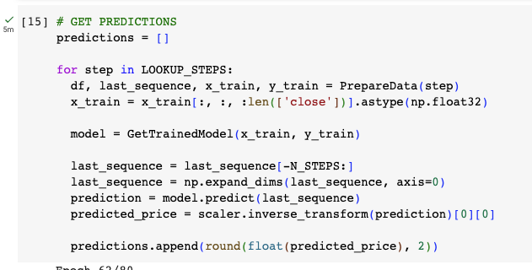
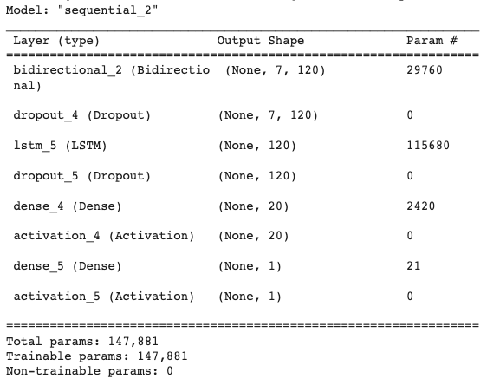
Model 4 - LSTM using Closing Price Only
Runtime: 5 mins.
MAPE: 1.84%
MAE: $4.305
RMSE: $5.369
Notes:
The GetTrainedModel function is called three times because we are trying to predict the stock closing price for 3 days after the last date of our data - June 1, 2, and 3. For each run it creates a new instance of the model, compiles it, trains it on the provided training data, and returns the trained model.
This model took 5 mins to run and as the model runs, the code provides information about the time taken to process each step and the value of the loss function for that epoch. The loss value represents the average difference between the predicted values and the actual values. The smaller the value, shows how well the model is performing, indicating that the model is able to fit the training data well and minimize the difference between predicted and actual values.
At the end of each instance, a model summary is produced and provides a summary of the architecture of the neural network model. For example, for the first run: Model: "sequential": Indicates that the model is of sequential type, meaning the layers are stacked sequentially.
The summary shows the Layer (type, Output Shape, and Param # of each layer in the model.
First layer is the bidirectional LSTM layer. It has an output shape of (8, 7, 120), indicating that it outputs a tensor of shape (8, 7, 120). The layer has 29,760 trainable parameters. bidirectional (Bidirectional (8, 7, 120) 29760:
The second layer is a dropout layer which is a regularization technique commonly used in neural networks to prevent overfitting, which can happen when the model becomes too specialized to the training data. It basically sets a fraction, in this case we set it to 0.3, which means 30% of the input units will be set to zero. This later will have the same output shape as the previous layer (8, 7, 120) and dropout layers do not have any trainable parameters.
dropout (Dropout) (8, 7, 120) 0
The third layer is a unidirectional LSTM layer. It has an output shape of (8, 120), indicating that it outputs a tensor of shape (8, 120). The layer has 115,680 trainable parameters. : lstm_1 (LSTM) (8, 120) 115680:
Then we do another dropout layer, followed by a dense layer, which is a type of layer that consists of fully connected neurons. Which means each neuron in the dense layer receives input from every neuron in the previous layer and produces an output. The dense layer is usually used in a LSTM model to contribute to the model’s ability to learn complex patterns and make predictions based on those patterns. It performs a nonlinear transformation of the input data, allowing the model to capture and represent more intricate relationships between the input features. Introducing it here allows us to use the ‘relu’ activation function in the next layer. This flexibility enables the model to learn and generalize from the training data, making it better equipped to handle unseen or new data during the prediction phase.
The number of neurons in the dense layer, in the first dense layer is 20, represents the dimensionality or complexity of the learned representation. More neurons allow the model to capture more intricate patterns and potentially improve its predictive performance however too many can also cause overfitting so in the last dense layer, we only used 1. The Dense layer with 1 neuron is often used as the final layer when the goal is to predict a continuous value like stock prices. The layer condenses the learned representations from the previous layers into a single output value, which represents the predicted stock price.
The relu activation is typically applied to the output of a dense layer or another hidden layer. it returns 0 for all negative input values and passes positive input values unchanged.Doing that addresses the vanishing gradient problem which occurs when the gradients become extremely small making it difficult for the model to learn and update the weights properly.
dropout_1 (Dropout) (8, 120) 0: Represents another dropout layer. It has the same output shape as the previous layer (8, 120) and does not have any trainable parameters.
dense (Dense) (8, 20) 2420: Represents a dense (fully connected) layer. It has an output shape of (8, 20), indicating that it outputs a tensor of shape (8, 20). The layer has 2,420 trainable parameters.
activation (Activation) (8, 20) 0: Represents an activation layer. It has the same output shape as the previous layer (8, 20) and does not have any trainable parameters.
dense_1 (Dense) (8, 1) 21: Represents the final dense layer. It has an output shape of (8, 1), indicating that it outputs a tensor of shape (8, 1). The layer has 21 trainable parameters.
activation_1 (Activation) (8, 1) 0: Represents the final activation layer. It has the same output shape as the previous layer (8, 1) and does not have any trainable parameters.
Total params: 147,881: Shows the total number of trainable parameters in the model.
Trainable params: 147,881: Indicates the number of trainable parameters in the model that will be updated during training.
Non-trainable params: 0: Represents the number of non-trainable parameters in the model, which are fixed and not updated during training. In this case, there are no non-trainable parameters.

Slide 16
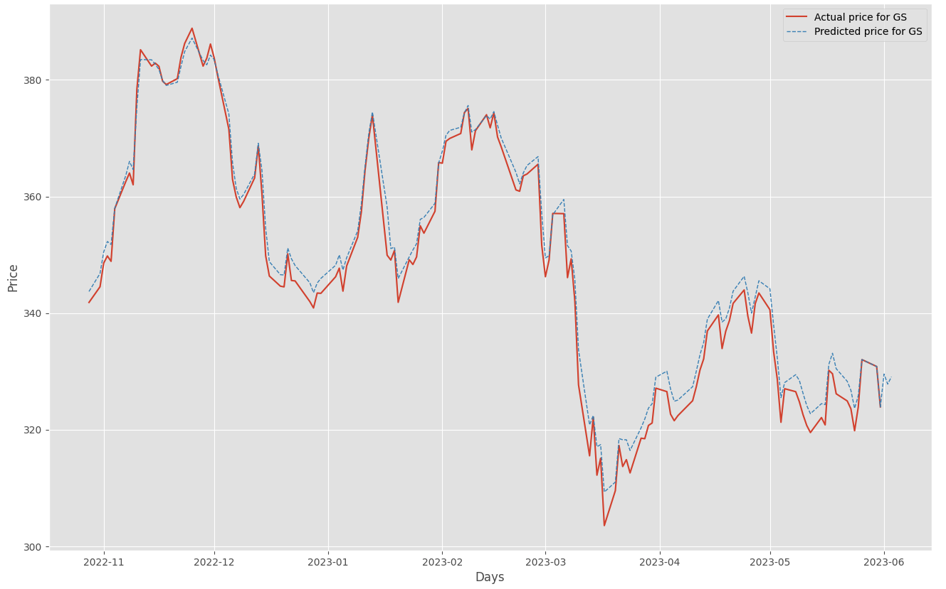
Model 4 - LSTM using Closing Price Only
Goldman Sachs stock prediction for 6/1, 6/2, 6/3 = $329.53, $327.81, $329.06
Notes:
On this graph, we plotted the predicted prices vs. the actual prices for our entire dataset.
ONLY mention this if someone asks: It should be noted, that rather than splitting our data into training and testing sets, we used the same dataset for both training and testing.
The common practice is to split the available dataset into three parts: training set, validation set, and testing set. The training set is used to train the model, the validation set is used to fine-tune the model and make decisions about hyperparameters, and the testing set is used to evaluate the final performance of the model.
By using separate datasets for training and testing, you can assess how well the model generalizes to unseen data. Testing the model on unseen data is crucial to determine its performance in real-world scenarios and to avoid overfitting,

Slide 17
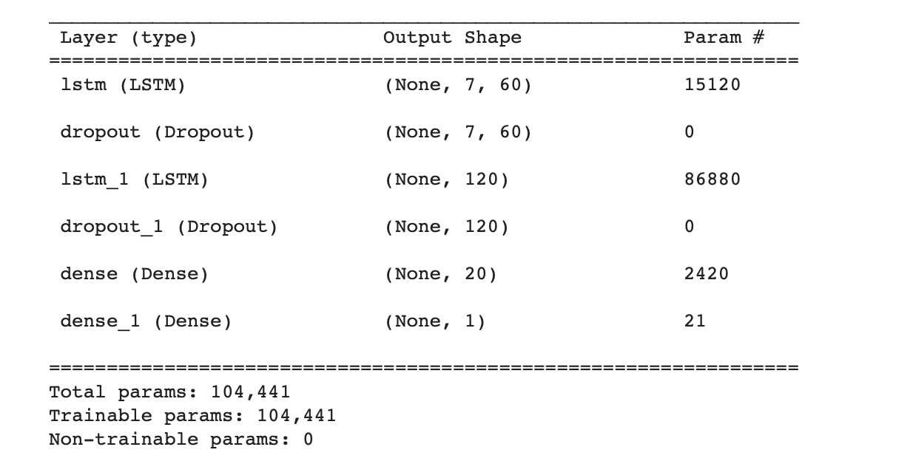
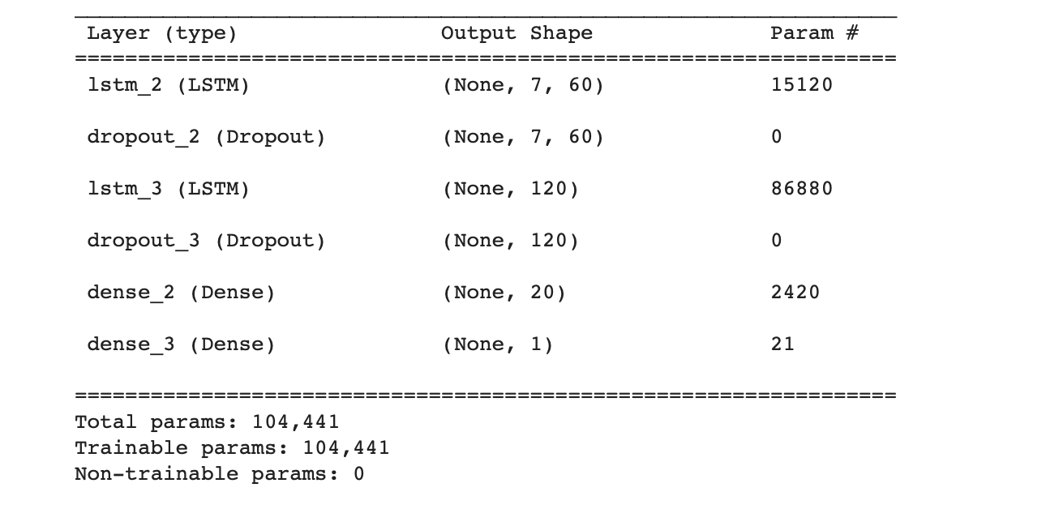
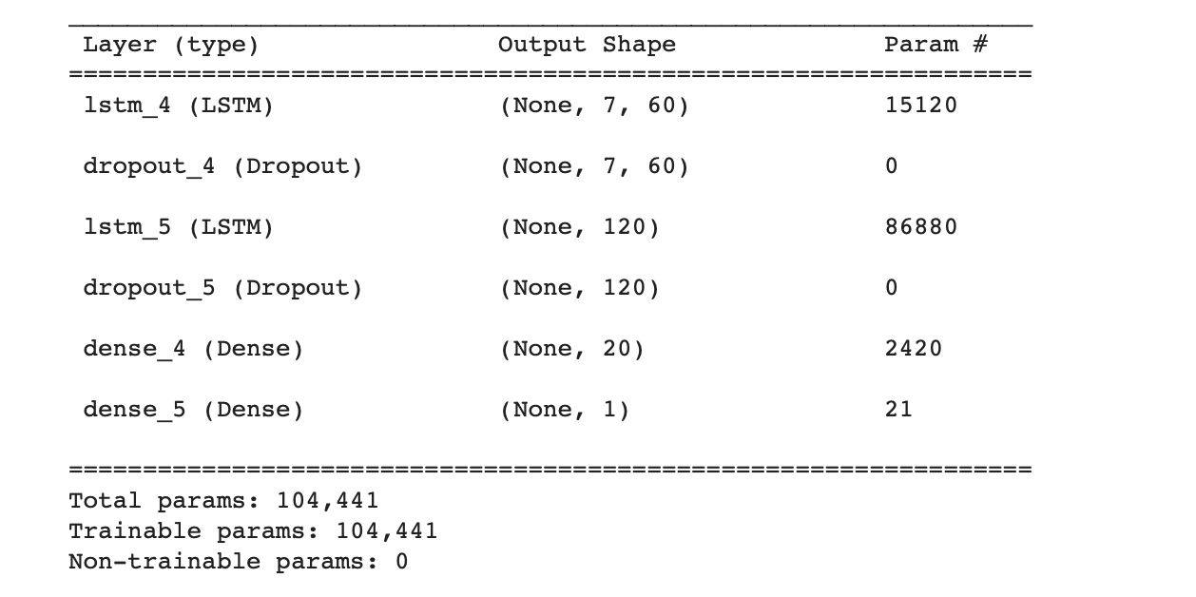
Model 5 - LSTM using Closing Price and Market Indicators
Runtime about 3 minutes
MAE ($3.4)
RMSE ($4.54)
MAPE (1.34%)
Notes:
-Very similar to previous LSTM model, just with added data from FRED to include the federal funds effective rate (interest rate banks use to borrow money from each other, updated daily)
-Added scaler to normalize data. Applied to “DFF” and “Close”
-Normalized data was then prepared to intake a set number of days and fed into the machine learning model
-Keras library was used to train the learning model. Training model utilized LSTM layers, dropout layers for regularization, and dense layers for fully connected layers. Each of which has 104,441 trainable parameters.
-Trained learning model was then used to predict stock prices for the upcoming three days.
-In order to check accuracy, we looked at the following
-MAE ($3.4)
-RMSE ($4.54)
-MAPE (1.34%)

Slide 18
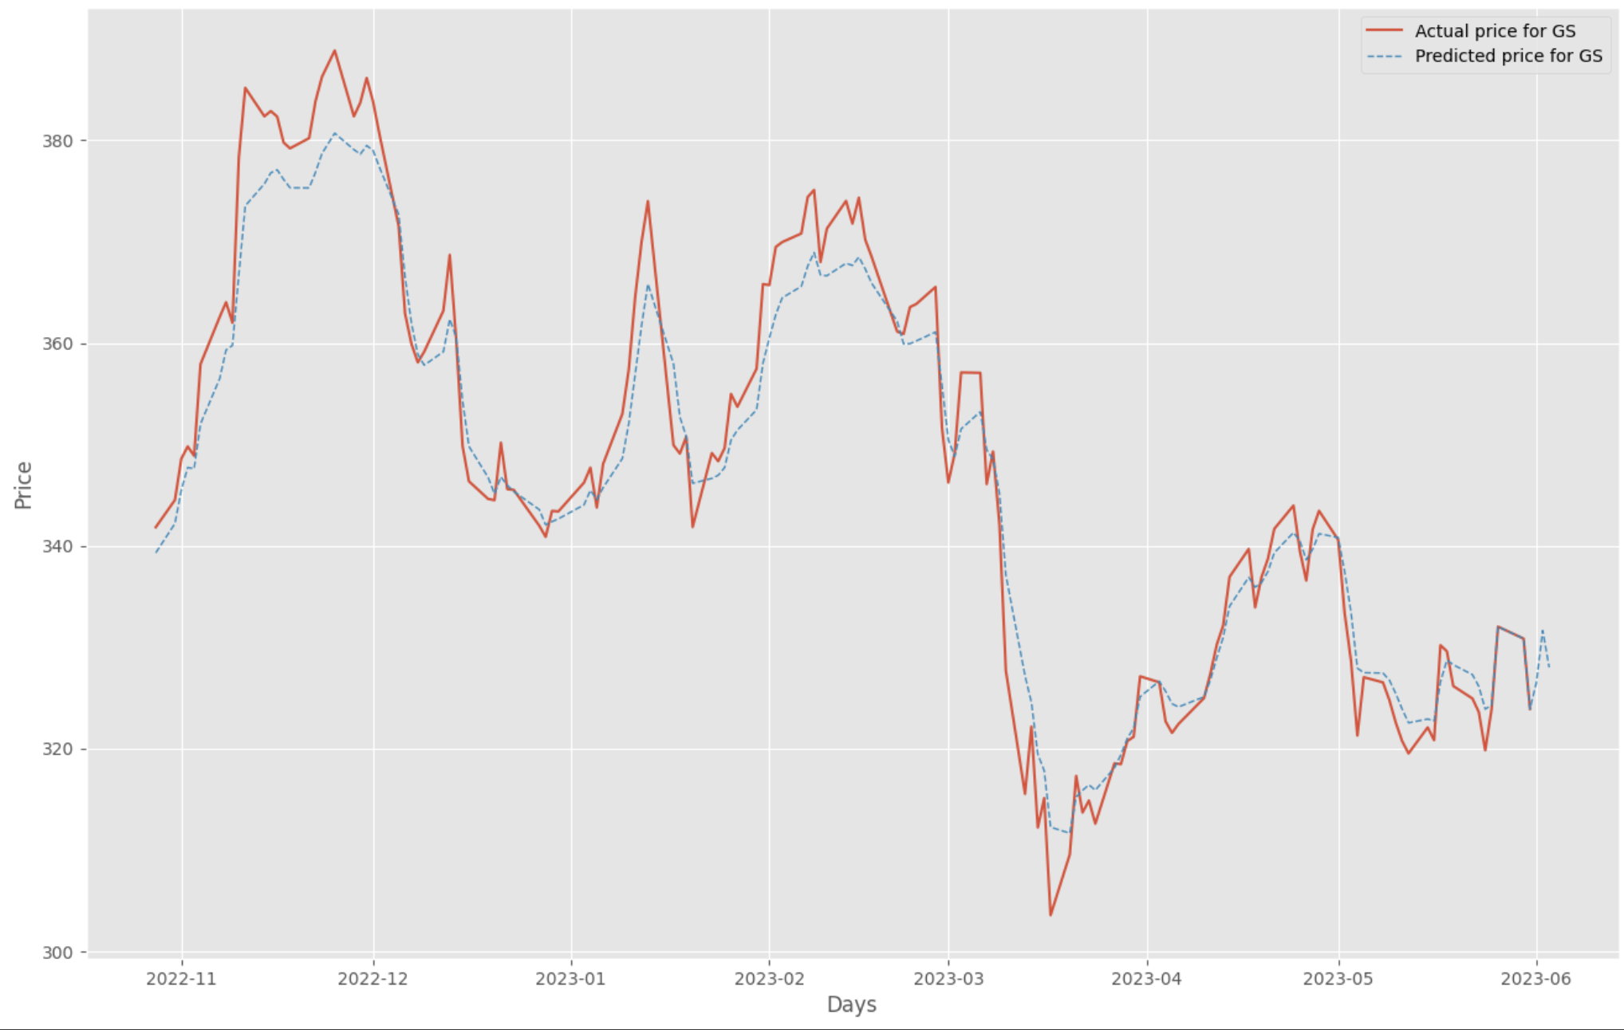
Model 5 - LSTM using Closing Price and Market Indicators
Goldman Sachs stock prediction for 6/1, 6/2, 6/3 = $326.48, $331.63, $327.99
Notes:
-Initially, the model was much less accurate. We believe adding the scaler to normalize the data really helped that as the indicator chosen is relatively volatile and therefore subject to outliers.

Slide 19
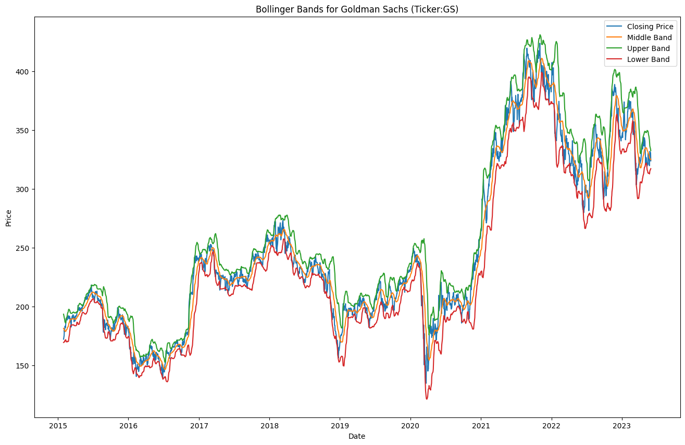
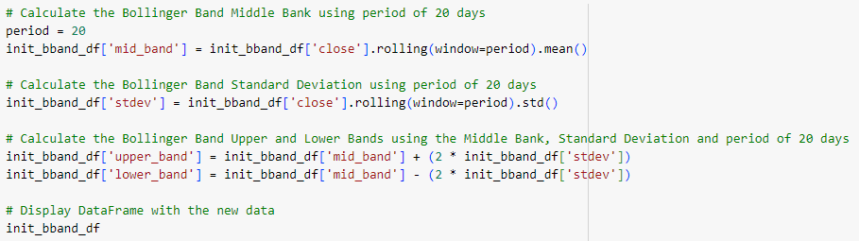
Model 6 - LSTM using Closing Price and Technical Indicators
Sequential LSTM model with 8 layers
90 Epochs
2016 to June 2023
Implementation of BBands
Notes:
In our final model we built upon Model 4 by including Bollinger Bands, a common technical indicator in stock analysis, to our model. Bollinger Bands, also known as BBands help analysts identify potential trends and volatility by creating three bands based on a simple moving average of the stock’s price over time. In our model we used a period of 20 days. Therefore the middle band was a 20 day simple moving average. We then calculated the standard deviation and used the middle band plus and minus 2 standard deviations to find the upper and lower bands.In this model we also increased the time period to go back to 2015.

Slide 20
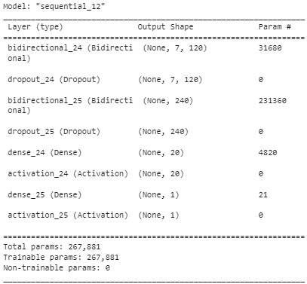
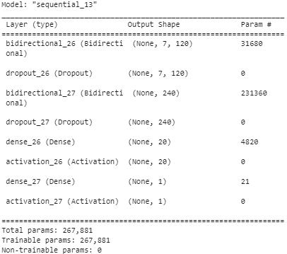
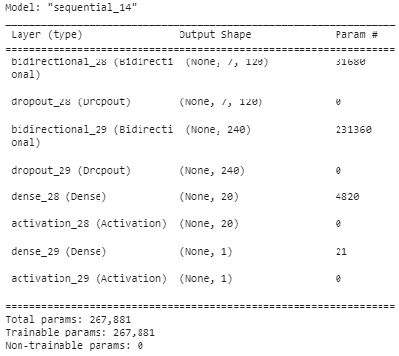
Model 6 - LSTM using Closing Price and Technical Indicators
Runtime: 29 mins.
MAPE: 1.19%
MAE: $2.70
RMSE: $3.77
Notes:
Given the addition of BBands and increasing the time period to 8 years, this model took 29 minutes to train and resulted in an improved MAPE of 1.19%. We ran multiple versions of this code with varying drop out rates, activation layers, and time periods to find the optimal model. Most iterations provided results with an MAPE in the higher 1% to mid 2%s and run time was heavily dependent on the time period, number of epochs, and the dropout rate.

Slide 21


Model 6 - LSTM using Closing Price and Technical Indicators
Additional Trials:
Increasing dropout rate, changing activation layers, changing time periods
Reduced time period to 5 years (18 min runtime):
Using Sigmoid activation layer instead of relu (14 min runtime):
Notes:
Here we can see two more sets of outputs from running different variations of the model by changing the dropout rate, activation layers, and time periods.

Slide 22
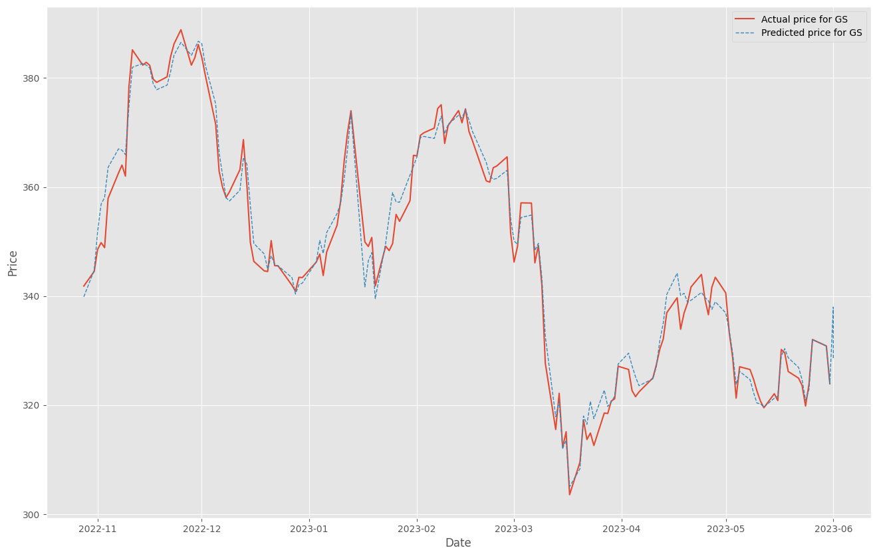
Model 6 - LSTM using Closing Price and Technical Indicators
Goldman Sachs stock prediction for 6/1, 6/2, 6/3 = $337.97, $328.71, $328.45
Notes:
Here we see the final predicted price vs actual price for GS using model 6.

Slide 23
Summary - Results
Metric | Model 1 | Model 2 | Model 3 | Model 4 | Model 5 | Model 6
 | Time Regression | Random Forest | ARIMA | LSTM | LSTM | LSTM
MAPE | 1.59% | 1.45% | 1.32% | 1.84% | 1.34% | 1.19%
MAE | $40.6 | $35.32 | $4.39 | $4.30 | $3.40 | $2.70
RMSE | $5.96 | $6.47 | $5.66 | $5.37 | $4.54 | $3.77
Notes:
On this graph, we plotted the predicted prices vs. the actual prices for our entire dataset.
ONLY mention this if someone asks: It should be noted, that rather than splitting our data into training and testing sets, we used the same dataset for both training and testing.
The common practice is to split the available dataset into three parts: training set, validation set, and testing set. The training set is used to train the model, the validation set is used to fine-tune the model and make decisions about hyperparameters, and the testing set is used to evaluate the final performance of the model.
By using separate datasets for training and testing, you can assess how well the model generalizes to unseen data. Testing the model on unseen data is crucial to determine its performance in real-world scenarios and to avoid overfitting,

Slide 24
Conclusion
Based on the performance metrics of each model, the LSTM neural network (Model 6) had the best MAPE value.
However, ARIMA model, provided that it only used Closing Prices (from 1995 to 2023) came close.
LSTM model is better suited to predict the stock market given that It excels at capturing nonlinear relationships, allowing it to capture complex patterns and relationships between stock market features.
Stock market behavior is influenced by numerous factors, including economic indicators, geopolitical events, investor sentiment, and unforeseen events. ML models may struggle to capture the full complexity and interplay of these factors.

